Slide 1










EV SALES
Electric Vehicle Sales by State in India
Tools Used: Excel, Pivot Tables, SQ
Created by : Diya Singh

Slide 2

PROJECT OBJECTIVE
To analyze EV sales trends across Indian states.
To identify top-performing states and vehicle categories.
To study year-wise growth from 2014 to 2024.
To build an interactive Excel Dashboard.
To perform SQL-based data analysis for deeper insights.

Slide 3


DATASET OVERVIEW
Rows: 96,845
Columns: Year, Month, Date, State, Vehicle Class, Category, Type, EV Sales Quantity
Time period: 2014 to 2024
Source: Provided dataset
All data was cleaned and structured before analysis.
DATA CLEANING SUMMARY
Removed blank rows
Converted Date column to proper date format
Verified data types (Year = integer, Sales = integer)
Added additional columns (Year from Date where needed)
Ensured no missing values
Verified states and categories

Slide 4


TOOLS USED
Following tools were used to demonstrate the sales of electronic vehicles sales in India.
EXCEL
SQL
Pivot Tables
Charts
Dashboard design
Slicers
KPI boxes
Aggregations
Group-by operations
Filters
Distinct counts

Slide 5
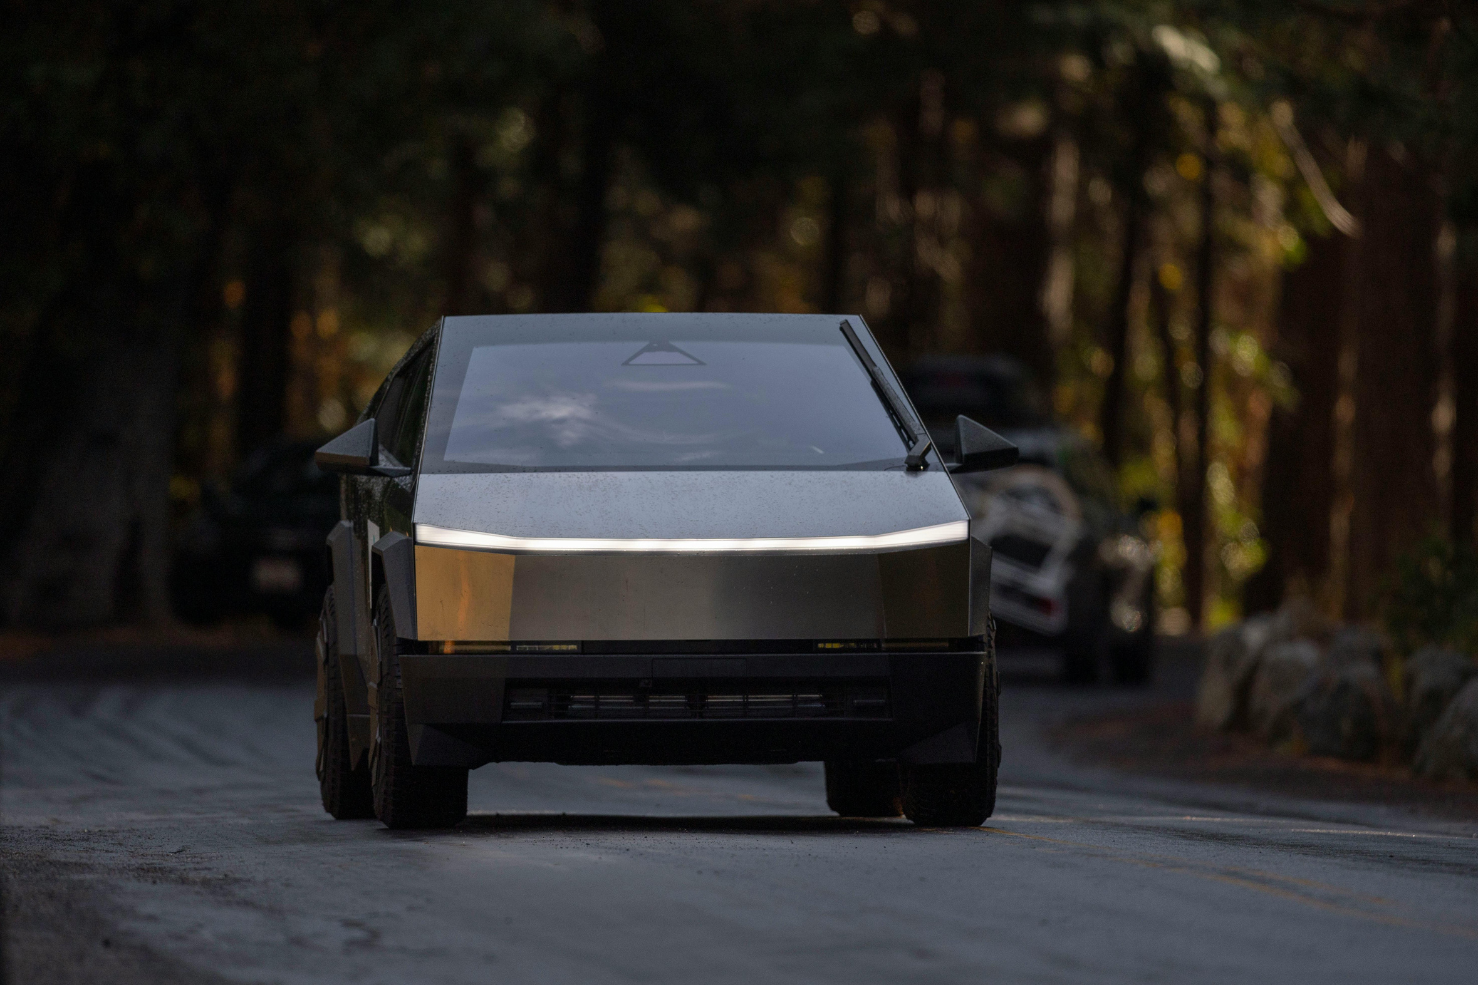


SQL ANALYSIS
Total electronic vehicle sales :
SELECT SUM(c8) AS Total_Sales
FROM EVsales;
result : 3593811
TYPE A
TYPE B
TYPE C

Slide 6

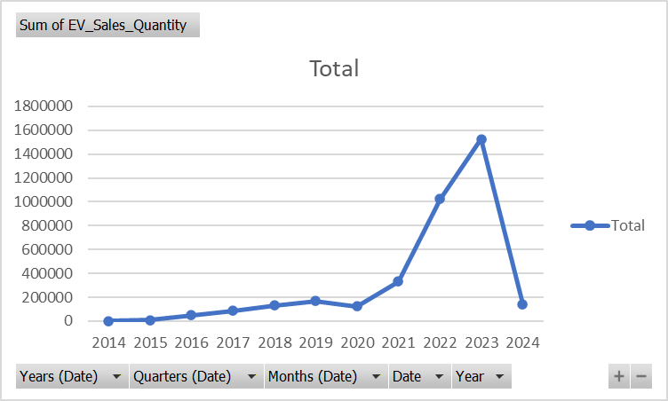




NO OF STATES
Insights:
The dataset covers Electronic Vehicles sales across 35 states and union territories.
CODE: SELECT COUNT(DISTINCT c4) AS Number_of_States FROM EVsales;
YEARS COVERED
Insight:
The EV market shows 11-year continuous growth.
CODE: SELECT COUNT(DISTINCT c1) AS Years_Covered FROM EVsales;

Slide 7
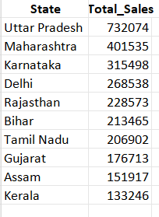
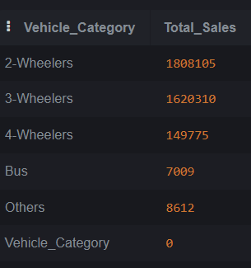
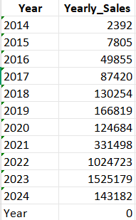
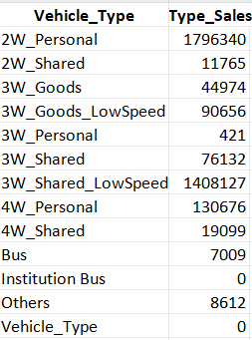
02
Year wise sales
04
Vehicle Type Sales
CODE: SELECT c1 AS Year, SUM(c8) AS Yearly_Sales FROM EVsales GROUP BY c1 ORDER BY Year;
CODE: SELECT c7 AS Vehicle_Type, SUM(c8) AS Type_Sales FROM EVsales GROUP BY c7;
01
Top 10 states
03
Category-wise sales
CODE: SELECT c4 AS State, SUM(c8) AS Total_Sales FROM EVsales GROUP BY c4 ORDER BY Total_Sales DESC LIMIT 10;
CODE: SELECT c6 AS Vehicle_Category, SUM(c8) AS Total_Sales FROM EVsales GROUP BY c6;

Slide 8
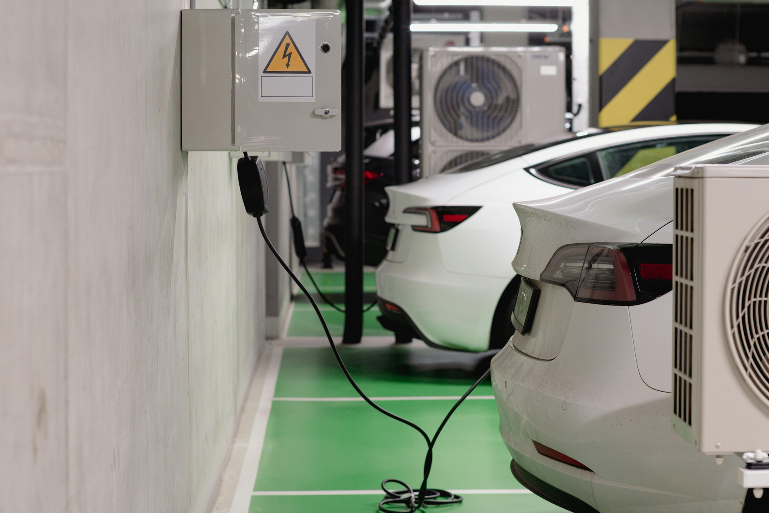
🔑 KEY FINDINGS & INSIGHTS
Strong EV Growth Trend:
EV sales in India have shown a consistent upward trend from 2014 to 2024, indicating rising adoption and awareness.
Rapid Growth After 2019:
A sharp increase in EV sales is observed post-2019, driven by government incentives, policy support, and improved charging infrastructure.
Top Performing States:
Uttar Pradesh, Maharashtra, and Karnataka emerge as the leading states in EV sales, reflecting higher urbanization and policy-driven adoption.
Wide Geographic Coverage:
EV adoption spans across 34 states and union territories, showing nationwide penetration rather than regional limitation.
Dominance of Passenger & Light EVs:
Passenger vehicles and the “Others” category (2-wheelers & autos) account for the largest share of EV sales, highlighting affordability and daily-use demand.
Emerging Commercial EV Segment:
Growth in goods and public transport EVs (buses, taxis) indicates a shift toward sustainable commercial mobility.

Slide 9

BUSINESS & POLICY INSIGHTS
Government policies and subsidies play a critical role in accelerating EV adoption.
Urban states show faster adoption due to charging infrastructure availability.
Two-wheelers remain the key driver of EV market expansion in India.
Continued investment in infrastructure can further boost adoption in Tier-2 & Tier-3 cities.
Data-driven dashboards and SQL analysis help in strategic decision-making.

Slide 10

CONCLUSION
This project analyzed electric vehicle sales across Indian states from 2014 to 2024 using Excel and SQL techniques. The analysis reveals a strong and consistent growth in EV adoption, particularly after 2019, driven by government initiatives, rising environmental awareness, and improvements in charging infrastructure. State-wise analysis shows that Uttar Pradesh, Maharashtra, and Karnataka lead in EV sales, indicating higher adoption in urbanized and policy-supported regions. Category-wise results highlight the dominance of passenger vehicles and light electric vehicles, reflecting their affordability and suitability for daily use. Overall, the findings demonstrate that India’s EV market is expanding steadily across regions and vehicle types, underscoring the country’s transition toward sustainable and cleaner mobility.

Slide 11

THANK YOU!
~DIYA SINGH

